Slide 1

Annual Research Review
19 August 2019
David Meredith
dave@create.aau.dk

Slide 2
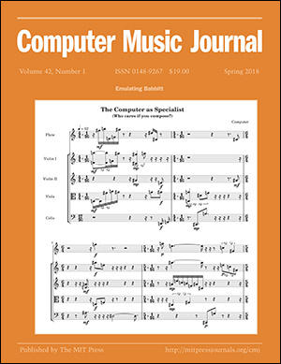
Research topics and recent papers
Computational modelling of Milton Babbitt's compositional processes
  Bemman, B. and Meredith, D. (2018). Generating new musical works in the style of Milton Babbitt. Computer Music Journal, 42(1). pp. 60-79.
  Bemman, B. and Meredith, D. (2018). Predicting Babbitt's orderings of time-point classes from array aggregate partitions in None but the Lonely Flute and Around the Horn. Journal of Mathematics and Music, 12(1):1-19.
  Bemman, B. and Meredith, D. (2019). Backtracking search heuristics for solving the all-partition array problem. 20th International Society for Music Information Retrieval Conference (ISMIR 2019), Delft, The Netherlands, 4-8 November 2019.
Convolutional methods for music analysis
  Velarde, G., Cancino Chacon, C., Meredith, D., Weyde, T. and Grachten, M. (2018). Convolution-based classification of audio and symbolic representations of music. Journal of New Music Research, 47(3). pp 191-205.
Deep learning methods for collision avoidance in mobile robots
  Schmuck, V. and Meredith, D. (2019). Training networks separately on static and dynamic obstacles improves collision avoidance during indoor robot navigation. 27th European Symposium on Artificial Neural Networks, Computational Intelligence and Machine Learning (ESANN 2019), Bruges, Belgium, 24-26 April, 2019.
Computational modelling of musical memory
  Agres, K. R. and Meredith, D. (2018). Modelling novice and expert listeners' ability to detect changes in short melodies. 15th International Conference on Music Perception and Cognition/10th Triennial Conference of the European Society for the Cognitive Sciences of Music (ICMPC15/ESCOM10), Graz, Austria, 23-28 July 2018.
Compression-based, geometric pattern discovery in music
  Meredith, D. (2019). Music analysis and data compression. In: Grimshaw-Aagaard, M., Walther-Hansen, M. & Knakkergaard, M. (eds.), The Oxford Handbook of Sound and Imagination, Vol. 2, Oxford University Press.
  Meredith, D. (2019). RECURSIA-RRT: Recursive translatable point-set pattern discovery with removal of redundant translators. 12th International Workshop on Machine Learning and Music (MML 2019), Würzburg, Germany, 16 September 2019.
  Schmuck, V. and Meredith, D. (2019). OPTISIA: An evolutionary approach to parameter optimisation in a family of point-set pattern-discovery algorithms. 12th International Workshop on Machine Learning and Music (MML 2019), Würzburg, Germany, 16 September 2019.

Slide 3
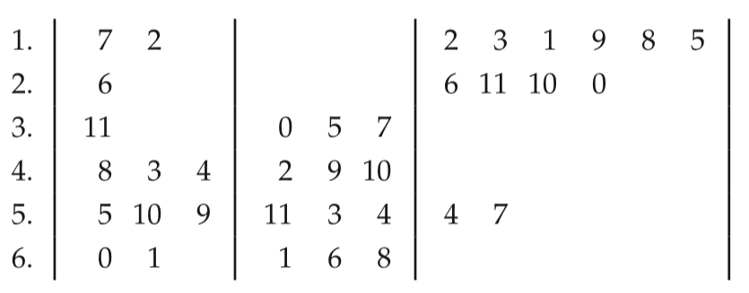
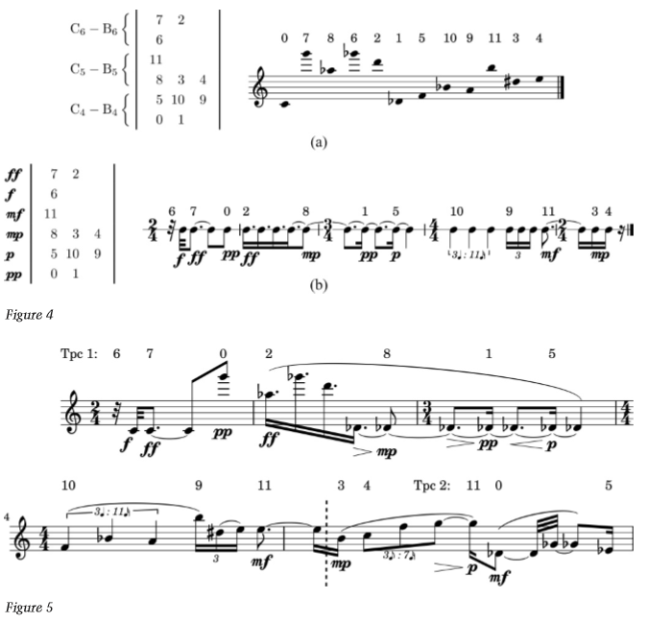
Research topics and recent papers
Computational modelling of Milton Babbitt's compositional processes
  Bemman, B. and Meredith, D. (2018). Generating new musical works in the style of Milton Babbitt. Computer Music Journal, 42(1). pp. 60-79.
  Bemman, B. and Meredith, D. (2018). Predicting Babbitt's orderings of time-point classes from array aggregate partitions in None but the Lonely Flute and Around the Horn. Journal of Mathematics and Music, 12(1):1-19.
  Bemman, B. and Meredith, D. (2019). Backtracking search heuristics for solving the all-partition array problem. 20th International Society for Music Information Retrieval Conference (ISMIR 2019), Delft, The Netherlands, 4-8 November 2019.
Convolutional methods for music analysis
  Velarde, G., Cancino Chacon, C., Meredith, D., Weyde, T. and Grachten, M. (2018). Convolution-based classification of audio and symbolic representations of music. Journal of New Music Research, 47(3). pp 191-205.
Deep learning methods for collision avoidance in mobile robots
  Schmuck, V. and Meredith, D. (2019). Training networks separately on static and dynamic obstacles improves collision avoidance during indoor robot navigation. 27th European Symposium on Artificial Neural Networks, Computational Intelligence and Machine Learning (ESANN 2019), Bruges, Belgium, 24-26 April, 2019.
Computational modelling of musical memory
  Agres, K. R. and Meredith, D. (2018). Modelling novice and expert listeners' ability to detect changes in short melodies. 15th International Conference on Music Perception and Cognition/10th Triennial Conference of the European Society for the Cognitive Sciences of Music (ICMPC15/ESCOM10), Graz, Austria, 23-28 July 2018.
Compression-based, geometric pattern discovery in music
  Meredith, D. (2019). Music analysis and data compression. In: Grimshaw-Aagaard, M., Walther-Hansen, M. & Knakkergaard, M. (eds.), The Oxford Handbook of Sound and Imagination, Vol. 2, Oxford University Press.
  Meredith, D. (2019). RECURSIA-RRT: Recursive translatable point-set pattern discovery with removal of redundant translators. 12th International Workshop on Machine Learning and Music (MML 2019), Würzburg, Germany, 16 September 2019.
  Schmuck, V. and Meredith, D. (2019). OPTISIA: An evolutionary approach to parameter optimisation in a family of point-set pattern-discovery algorithms. 12th International Workshop on Machine Learning and Music (MML 2019), Würzburg, Germany, 16 September 2019.

Slide 4
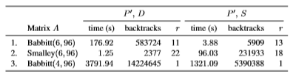
Research topics and recent papers
Computational modelling of Milton Babbitt's compositional processes
  Bemman, B. and Meredith, D. (2018). Generating new musical works in the style of Milton Babbitt. Computer Music Journal, 42(1). pp. 60-79.
  Bemman, B. and Meredith, D. (2018). Predicting Babbitt's orderings of time-point classes from array aggregate partitions in None but the Lonely Flute and Around the Horn. Journal of Mathematics and Music, 12(1):1-19.
  Bemman, B. and Meredith, D. (2019). Backtracking search heuristics for solving the all-partition array problem. 20th International Society for Music Information Retrieval Conference (ISMIR 2019), Delft, The Netherlands, 4-8 November 2019.
Convolutional methods for music analysis
  Velarde, G., Cancino Chacon, C., Meredith, D., Weyde, T. and Grachten, M. (2018). Convolution-based classification of audio and symbolic representations of music. Journal of New Music Research, 47(3). pp 191-205.
Deep learning methods for collision avoidance in mobile robots
  Schmuck, V. and Meredith, D. (2019). Training networks separately on static and dynamic obstacles improves collision avoidance during indoor robot navigation. 27th European Symposium on Artificial Neural Networks, Computational Intelligence and Machine Learning (ESANN 2019), Bruges, Belgium, 24-26 April, 2019.
Computational modelling of musical memory
  Agres, K. R. and Meredith, D. (2018). Modelling novice and expert listeners' ability to detect changes in short melodies. 15th International Conference on Music Perception and Cognition/10th Triennial Conference of the European Society for the Cognitive Sciences of Music (ICMPC15/ESCOM10), Graz, Austria, 23-28 July 2018.
Compression-based, geometric pattern discovery in music
  Meredith, D. (2019). Music analysis and data compression. In: Grimshaw-Aagaard, M., Walther-Hansen, M. & Knakkergaard, M. (eds.), The Oxford Handbook of Sound and Imagination, Vol. 2, Oxford University Press.
  Meredith, D. (2019). RECURSIA-RRT: Recursive translatable point-set pattern discovery with removal of redundant translators. 12th International Workshop on Machine Learning and Music (MML 2019), Würzburg, Germany, 16 September 2019.
  Schmuck, V. and Meredith, D. (2019). OPTISIA: An evolutionary approach to parameter optimisation in a family of point-set pattern-discovery algorithms. 12th International Workshop on Machine Learning and Music (MML 2019), Würzburg, Germany, 16 September 2019.
Problem: Left-to-right greedy backtracking algorithm typically gets into trouble towards the end of the sequence
Solution: Two heuristics
1. Avoid using partitions that work at the end until you need to
2. Minimise "raggedness" at leading edge of solution.

Slide 5
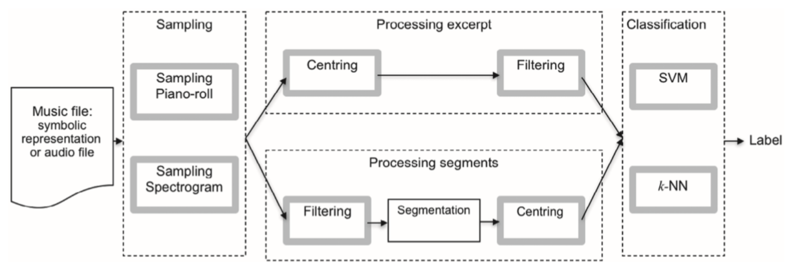
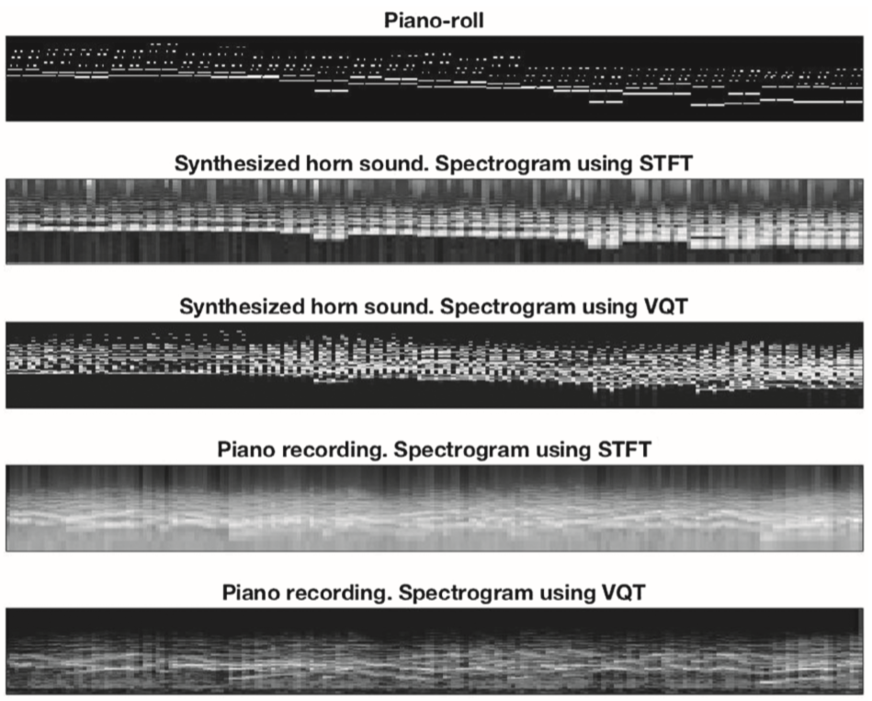
Research topics and recent papers
Computational modelling of Milton Babbitt's compositional processes
  Bemman, B. and Meredith, D. (2018). Generating new musical works in the style of Milton Babbitt. Computer Music Journal, 42(1). pp. 60-79.
  Bemman, B. and Meredith, D. (2018). Predicting Babbitt's orderings of time-point classes from array aggregate partitions in None but the Lonely Flute and Around the Horn. Journal of Mathematics and Music, 12(1):1-19.
  Bemman, B. and Meredith, D. (2019). Backtracking search heuristics for solving the all-partition array problem. 20th International Society for Music Information Retrieval Conference (ISMIR 2019), Delft, The Netherlands, 4-8 November 2019.
Convolutional methods for music analysis
  Velarde, G., Cancino Chacon, C., Meredith, D., Weyde, T. and Grachten, M. (2018). Convolution-based classification of audio and symbolic representations of music. Journal of New Music Research, 47(3). pp 191-205.
Deep learning methods for collision avoidance in mobile robots
  Schmuck, V. and Meredith, D. (2019). Training networks separately on static and dynamic obstacles improves collision avoidance during indoor robot navigation. 27th European Symposium on Artificial Neural Networks, Computational Intelligence and Machine Learning (ESANN 2019), Bruges, Belgium, 24-26 April, 2019.
Computational modelling of musical memory
  Agres, K. R. and Meredith, D. (2018). Modelling novice and expert listeners' ability to detect changes in short melodies. 15th International Conference on Music Perception and Cognition/10th Triennial Conference of the European Society for the Cognitive Sciences of Music (ICMPC15/ESCOM10), Graz, Austria, 23-28 July 2018.
Compression-based, geometric pattern discovery in music
  Meredith, D. (2019). Music analysis and data compression. In: Grimshaw-Aagaard, M., Walther-Hansen, M. & Knakkergaard, M. (eds.), The Oxford Handbook of Sound and Imagination, Vol. 2, Oxford University Press.
  Meredith, D. (2019). RECURSIA-RRT: Recursive translatable point-set pattern discovery with removal of redundant translators. 12th International Workshop on Machine Learning and Music (MML 2019), Würzburg, Germany, 16 September 2019.
  Schmuck, V. and Meredith, D. (2019). OPTISIA: An evolutionary approach to parameter optimisation in a family of point-set pattern-discovery algorithms. 12th International Workshop on Machine Learning and Music (MML 2019), Würzburg, Germany, 16 September 2019.

Slide 6
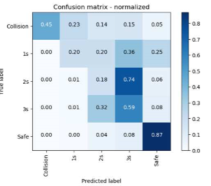
Research topics and recent papers
Computational modelling of Milton Babbitt's compositional processes
  Bemman, B. and Meredith, D. (2018). Generating new musical works in the style of Milton Babbitt. Computer Music Journal, 42(1). pp. 60-79.
  Bemman, B. and Meredith, D. (2018). Predicting Babbitt's orderings of time-point classes from array aggregate partitions in None but the Lonely Flute and Around the Horn. Journal of Mathematics and Music, 12(1):1-19.
  Bemman, B. and Meredith, D. (2019). Backtracking search heuristics for solving the all-partition array problem. 20th International Society for Music Information Retrieval Conference (ISMIR 2019), Delft, The Netherlands, 4-8 November 2019.
Convolutional methods for music analysis
  Velarde, G., Cancino Chacon, C., Meredith, D., Weyde, T. and Grachten, M. (2018). Convolution-based classification of audio and symbolic representations of music. Journal of New Music Research, 47(3). pp 191-205.
Deep learning methods for collision avoidance in mobile robots
  Schmuck, V. and Meredith, D. (2019). Training networks separately on static and dynamic obstacles improves collision avoidance during indoor robot navigation. 27th European Symposium on Artificial Neural Networks, Computational Intelligence and Machine Learning (ESANN 2019), Bruges, Belgium, 24-26 April, 2019.
Computational modelling of musical memory
  Agres, K. R. and Meredith, D. (2018). Modelling novice and expert listeners' ability to detect changes in short melodies. 15th International Conference on Music Perception and Cognition/10th Triennial Conference of the European Society for the Cognitive Sciences of Music (ICMPC15/ESCOM10), Graz, Austria, 23-28 July 2018.
Compression-based, geometric pattern discovery in music
  Meredith, D. (2019). Music analysis and data compression. In: Grimshaw-Aagaard, M., Walther-Hansen, M. & Knakkergaard, M. (eds.), The Oxford Handbook of Sound and Imagination, Vol. 2, Oxford University Press.
  Meredith, D. (2019). RECURSIA-RRT: Recursive translatable point-set pattern discovery with removal of redundant translators. 12th International Workshop on Machine Learning and Music (MML 2019), Würzburg, Germany, 16 September 2019.
  Schmuck, V. and Meredith, D. (2019). OPTISIA: An evolutionary approach to parameter optimisation in a family of point-set pattern-discovery algorithms. 12th International Workshop on Machine Learning and Music (MML 2019), Würzburg, Germany, 16 September 2019.
Sensor-fusion, NN-based solutions for anticipating and avoiding collisions
Implemented on the Pepper
A DNN trained using laser and sonar readings
Each camera feed used to train a separate CNN
Models combined using a WAE
  Weights depended on accuracies of models
Methods that separately train for dynamic and static objects perform better

Slide 7
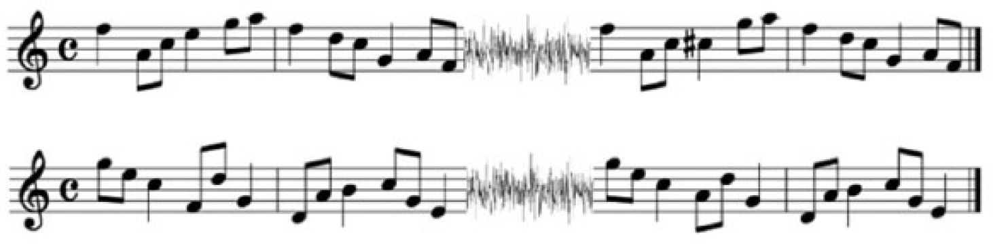
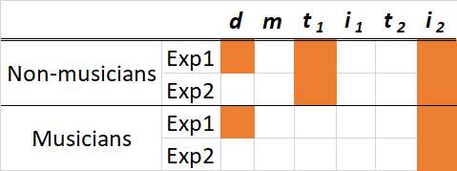
Research topics and recent papers
Computational modelling of Milton Babbitt's compositional processes
  Bemman, B. and Meredith, D. (2018). Generating new musical works in the style of Milton Babbitt. Computer Music Journal, 42(1). pp. 60-79.
  Bemman, B. and Meredith, D. (2018). Predicting Babbitt's orderings of time-point classes from array aggregate partitions in None but the Lonely Flute and Around the Horn. Journal of Mathematics and Music, 12(1):1-19.
  Bemman, B. and Meredith, D. (2019). Backtracking search heuristics for solving the all-partition array problem. 20th International Society for Music Information Retrieval Conference (ISMIR 2019), Delft, The Netherlands, 4-8 November 2019.
Convolutional methods for music analysis
  Velarde, G., Cancino Chacon, C., Meredith, D., Weyde, T. and Grachten, M. (2018). Convolution-based classification of audio and symbolic representations of music. Journal of New Music Research, 47(3). pp 191-205.
Deep learning methods for collision avoidance in mobile robots
  Schmuck, V. and Meredith, D. (2019). Training networks separately on static and dynamic obstacles improves collision avoidance during indoor robot navigation. 27th European Symposium on Artificial Neural Networks, Computational Intelligence and Machine Learning (ESANN 2019), Bruges, Belgium, 24-26 April, 2019.
Computational modelling of musical memory
  Agres, K. R. and Meredith, D. (2018). Modelling novice and expert listeners' ability to detect changes in short melodies. 15th International Conference on Music Perception and Cognition/10th Triennial Conference of the European Society for the Cognitive Sciences of Music (ICMPC15/ESCOM10), Graz, Austria, 23-28 July 2018.
Compression-based, geometric pattern discovery in music
  Meredith, D. (2019). Music analysis and data compression. In: Grimshaw-Aagaard, M., Walther-Hansen, M. & Knakkergaard, M. (eds.), The Oxford Handbook of Sound and Imagination, Vol. 2, Oxford University Press.
  Meredith, D. (2019). RECURSIA-RRT: Recursive translatable point-set pattern discovery with removal of redundant translators. 12th International Workshop on Machine Learning and Music (MML 2019), Würzburg, Germany, 16 September 2019.
  Schmuck, V. and Meredith, D. (2019). OPTISIA: An evolutionary approach to parameter optimisation in a family of point-set pattern-discovery algorithms. 12th International Workshop on Machine Learning and Music (MML 2019), Würzburg, Germany, 16 September 2019.
Top: A scale–non-scale trial containing a minor third non-scale tone change on the first metrical position of rhythm
Bottom: A scale–scale trial containing a major third tone change on the first metrical position of rhythm 2.

Slide 8
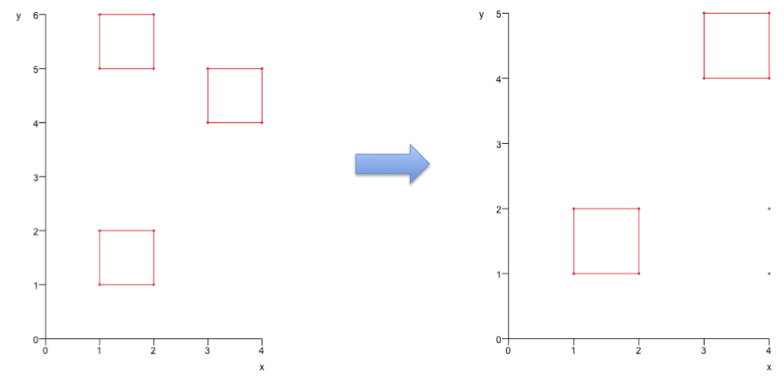
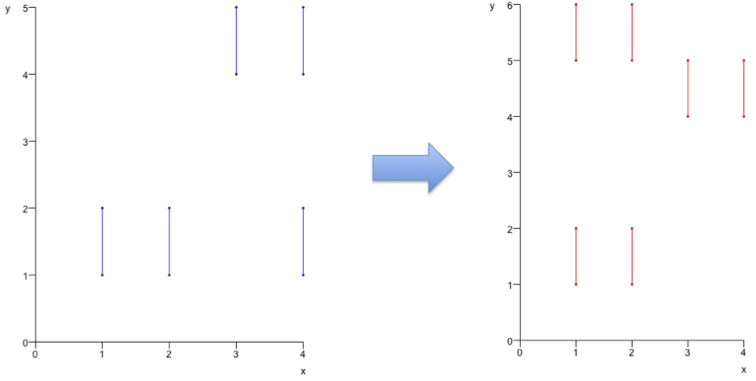
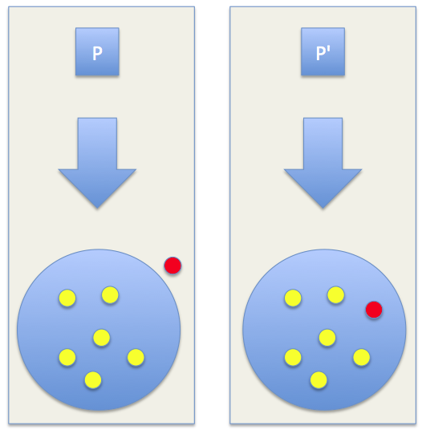
Research topics and recent papers
Computational modelling of Milton Babbitt's compositional processes
  Bemman, B. and Meredith, D. (2018). Generating new musical works in the style of Milton Babbitt. Computer Music Journal, 42(1). pp. 60-79.
  Bemman, B. and Meredith, D. (2018). Predicting Babbitt's orderings of time-point classes from array aggregate partitions in None but the Lonely Flute and Around the Horn. Journal of Mathematics and Music, 12(1):1-19.
  Bemman, B. and Meredith, D. (2019). Backtracking search heuristics for solving the all-partition array problem. 20th International Society for Music Information Retrieval Conference (ISMIR 2019), Delft, The Netherlands, 4-8 November 2019.
Convolutional methods for music analysis
  Velarde, G., Cancino Chacon, C., Meredith, D., Weyde, T. and Grachten, M. (2018). Convolution-based classification of audio and symbolic representations of music. Journal of New Music Research, 47(3). pp 191-205.
Deep learning methods for collision avoidance in mobile robots
  Schmuck, V. and Meredith, D. (2019). Training networks separately on static and dynamic obstacles improves collision avoidance during indoor robot navigation. 27th European Symposium on Artificial Neural Networks, Computational Intelligence and Machine Learning (ESANN 2019), Bruges, Belgium, 24-26 April, 2019.
Computational modelling of musical memory
  Agres, K. R. and Meredith, D. (2018). Modelling novice and expert listeners' ability to detect changes in short melodies. 15th International Conference on Music Perception and Cognition/10th Triennial Conference of the European Society for the Cognitive Sciences of Music (ICMPC15/ESCOM10), Graz, Austria, 23-28 July 2018.
Compression-based, geometric pattern discovery in music
  Meredith, D. (2019). Music analysis and data compression. In: Grimshaw-Aagaard, M., Walther-Hansen, M. & Knakkergaard, M. (eds.), The Oxford Handbook of Sound and Imagination, Vol. 2, Oxford University Press.
  Meredith, D. (2019). RECURSIA-RRT: Recursive translatable point-set pattern discovery with removal of redundant translators. 12th International Workshop on Machine Learning and Music (MML 2019), Würzburg, Germany, 16 September 2019.
  Schmuck, V. and Meredith, D. (2019). OPTISIA: An evolutionary approach to parameter optimisation in a family of point-set pattern-discovery algorithms. 12th International Workshop on Machine Learning and Music (MML 2019), Würzburg, Germany, 16 September 2019.

Slide 9
Research topics and recent papers
Computational modelling of Milton Babbitt's compositional processes
  Bemman, B. and Meredith, D. (2018). Generating new musical works in the style of Milton Babbitt. Computer Music Journal, 42(1). pp. 60-79.
  Bemman, B. and Meredith, D. (2018). Predicting Babbitt's orderings of time-point classes from array aggregate partitions in None but the Lonely Flute and Around the Horn. Journal of Mathematics and Music, 12(1):1-19.
  Bemman, B. and Meredith, D. (2019). Backtracking search heuristics for solving the all-partition array problem. 20th International Society for Music Information Retrieval Conference (ISMIR 2019), Delft, The Netherlands, 4-8 November 2019.
Convolutional methods for music analysis
  Velarde, G., Cancino Chacon, C., Meredith, D., Weyde, T. and Grachten, M. (2018). Convolution-based classification of audio and symbolic representations of music. Journal of New Music Research, 47(3). pp 191-205.
Deep learning methods for collision avoidance in mobile robots
  Schmuck, V. and Meredith, D. (2019). Training networks separately on static and dynamic obstacles improves collision avoidance during indoor robot navigation. 27th European Symposium on Artificial Neural Networks, Computational Intelligence and Machine Learning (ESANN 2019), Bruges, Belgium, 24-26 April, 2019.
Computational modelling of musical memory
  Agres, K. R. and Meredith, D. (2018). Modelling novice and expert listeners' ability to detect changes in short melodies. 15th International Conference on Music Perception and Cognition/10th Triennial Conference of the European Society for the Cognitive Sciences of Music (ICMPC15/ESCOM10), Graz, Austria, 23-28 July 2018.
Compression-based, geometric pattern discovery in music
  Meredith, D. (2019). Music analysis and data compression. In: Grimshaw-Aagaard, M., Walther-Hansen, M. & Knakkergaard, M. (eds.), The Oxford Handbook of Sound and Imagination, Vol. 2, Oxford University Press.
  Meredith, D. (2019). RECURSIA-RRT: Recursive translatable point-set pattern discovery with removal of redundant translators. 12th International Workshop on Machine Learning and Music (MML 2019), Würzburg, Germany, 16 September 2019.
  Schmuck, V. and Meredith, D. (2019). OPTISIA: An evolutionary approach to parameter optimisation in a family of point-set pattern-discovery algorithms. 12th International Workshop on Machine Learning and Music (MML 2019), Würzburg, Germany, 16 September 2019.

Slide 10
Research topics and recent papers
Computational modelling of Milton Babbitt's compositional processes
  Bemman, B. and Meredith, D. (2018). Generating new musical works in the style of Milton Babbitt. Computer Music Journal, 42(1). pp. 60-79.
  Bemman, B. and Meredith, D. (2018). Predicting Babbitt's orderings of time-point classes from array aggregate partitions in None but the Lonely Flute and Around the Horn. Journal of Mathematics and Music, 12(1):1-19.
  Bemman, B. and Meredith, D. (2019). Backtracking search heuristics for solving the all-partition array problem. 20th International Society for Music Information Retrieval Conference (ISMIR 2019), Delft, The Netherlands, 4-8 November 2019.
Convolutional methods for music analysis
  Velarde, G., Cancino Chacon, C., Meredith, D., Weyde, T. and Grachten, M. (2018). Convolution-based classification of audio and symbolic representations of music. Journal of New Music Research, 47(3). pp 191-205.
Deep learning methods for collision avoidance in mobile robots
  Schmuck, V. and Meredith, D. (2019). Training networks separately on static and dynamic obstacles improves collision avoidance during indoor robot navigation. 27th European Symposium on Artificial Neural Networks, Computational Intelligence and Machine Learning (ESANN 2019), Bruges, Belgium, 24-26 April, 2019.
Computational modelling of musical memory
  Agres, K. R. and Meredith, D. (2018). Modelling novice and expert listeners' ability to detect changes in short melodies. 15th International Conference on Music Perception and Cognition/10th Triennial Conference of the European Society for the Cognitive Sciences of Music (ICMPC15/ESCOM10), Graz, Austria, 23-28 July 2018.
Compression-based, geometric pattern discovery in music
  Meredith, D. (2019). Music analysis and data compression. In: Grimshaw-Aagaard, M., Walther-Hansen, M. & Knakkergaard, M. (eds.), The Oxford Handbook of Sound and Imagination, Vol. 2, Oxford University Press.
  Meredith, D. (2019). RECURSIA-RRT: Recursive translatable point-set pattern discovery with removal of redundant translators. 12th International Workshop on Machine Learning and Music (MML 2019), Würzburg, Germany, 16 September 2019.
  Schmuck, V. and Meredith, D. (2019). OPTISIA: An evolutionary approach to parameter optimisation in a family of point-set pattern-discovery algorithms. 12th International Workshop on Machine Learning and Music (MML 2019), Würzburg, Germany, 16 September 2019.
a
b
c
d
a
b
c
d

Slide 11
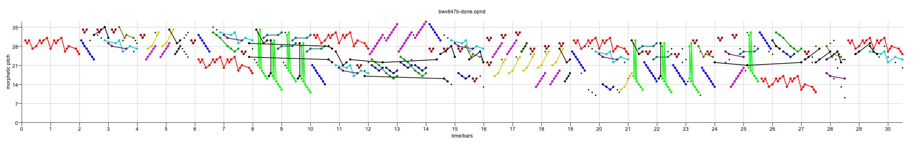
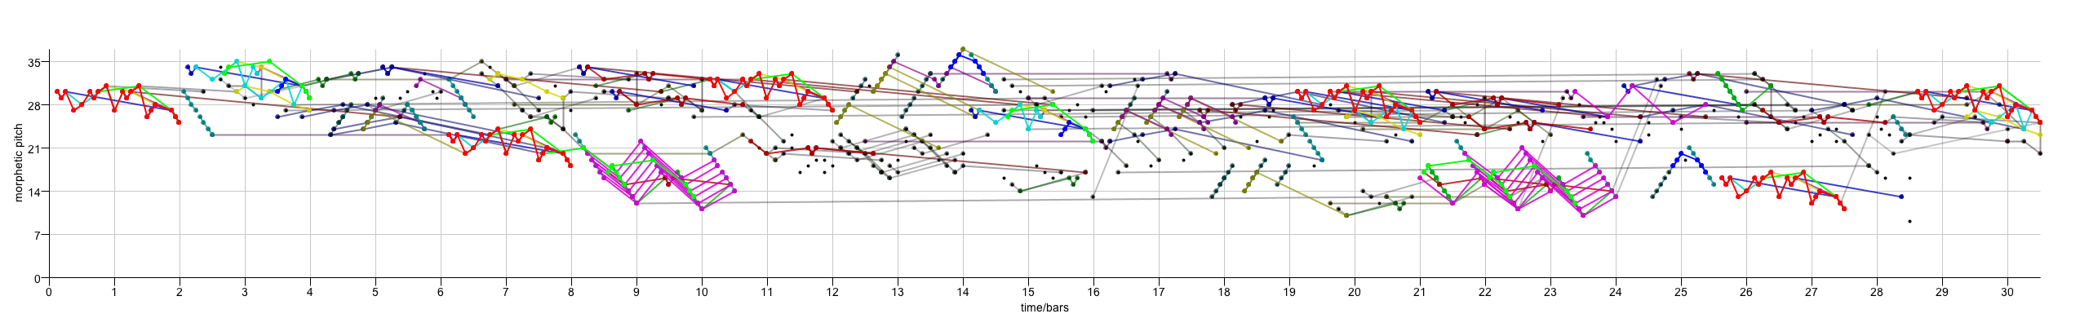
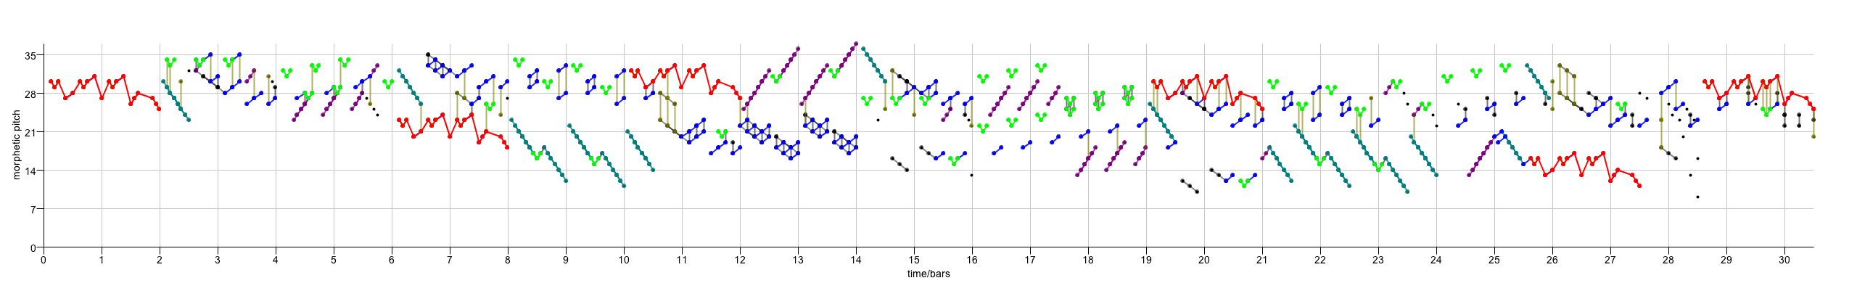
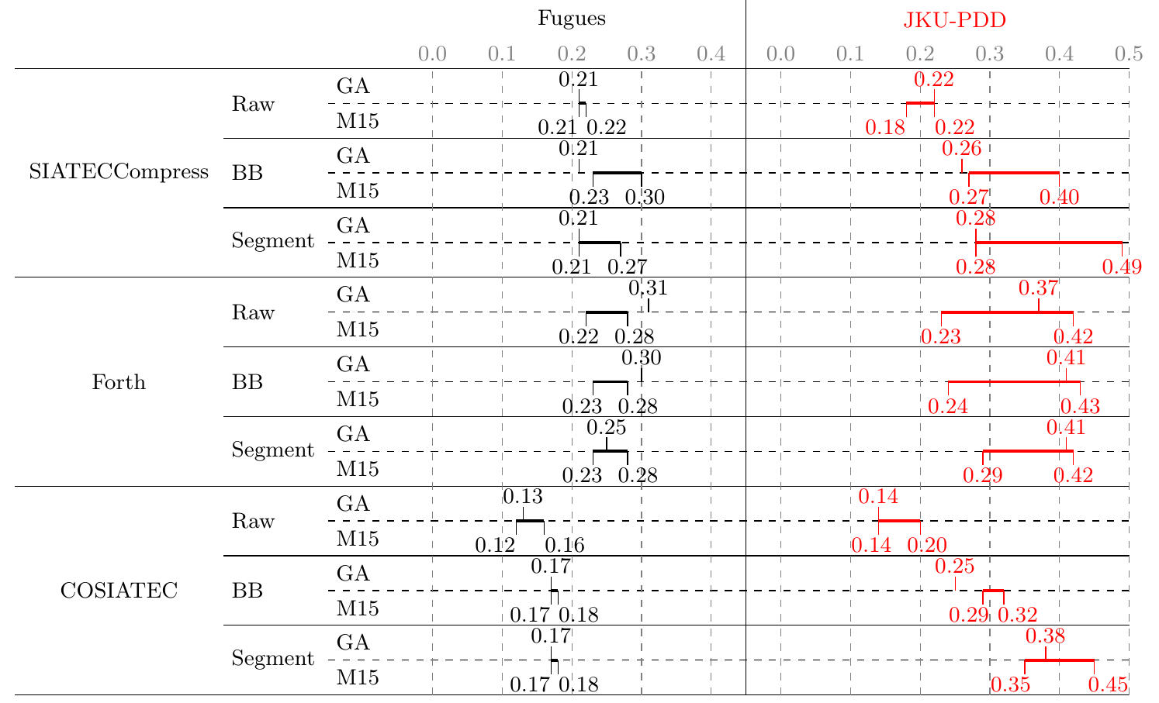
Research topics and recent papers
Computational modelling of Milton Babbitt's compositional processes
  Bemman, B. and Meredith, D. (2018). Generating new musical works in the style of Milton Babbitt. Computer Music Journal, 42(1). pp. 60-79.
  Bemman, B. and Meredith, D. (2018). Predicting Babbitt's orderings of time-point classes from array aggregate partitions in None but the Lonely Flute and Around the Horn. Journal of Mathematics and Music, 12(1):1-19.
  Bemman, B. and Meredith, D. (2019). Backtracking search heuristics for solving the all-partition array problem. 20th International Society for Music Information Retrieval Conference (ISMIR 2019), Delft, The Netherlands, 4-8 November 2019.
Convolutional methods for music analysis
  Velarde, G., Cancino Chacon, C., Meredith, D., Weyde, T. and Grachten, M. (2018). Convolution-based classification of audio and symbolic representations of music. Journal of New Music Research, 47(3). pp 191-205.
Deep learning methods for collision avoidance in mobile robots
  Schmuck, V. and Meredith, D. (2019). Training networks separately on static and dynamic obstacles improves collision avoidance during indoor robot navigation. 27th European Symposium on Artificial Neural Networks, Computational Intelligence and Machine Learning (ESANN 2019), Bruges, Belgium, 24-26 April, 2019.
Computational modelling of musical memory
  Agres, K. R. and Meredith, D. (2018). Modelling novice and expert listeners' ability to detect changes in short melodies. 15th International Conference on Music Perception and Cognition/10th Triennial Conference of the European Society for the Cognitive Sciences of Music (ICMPC15/ESCOM10), Graz, Austria, 23-28 July 2018.
Compression-based, geometric pattern discovery in music
  Meredith, D. (2019). Music analysis and data compression. In: Grimshaw-Aagaard, M., Walther-Hansen, M. & Knakkergaard, M. (eds.), The Oxford Handbook of Sound and Imagination, Vol. 2, Oxford University Press.
  Meredith, D. (2019). RECURSIA-RRT: Recursive translatable point-set pattern discovery with removal of redundant translators. 12th International Workshop on Machine Learning and Music (MML 2019), Würzburg, Germany, 16 September 2019.
  Schmuck, V. and Meredith, D. (2019). OPTISIA: An evolutionary approach to parameter optimisation in a family of point-set pattern-discovery algorithms. 12th International Workshop on Machine Learning and Music (MML 2019), Würzburg, Germany, 16 September 2019.
COSIATEC
SIATECCompress
Forth’s algorithm

Slide 12
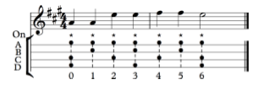
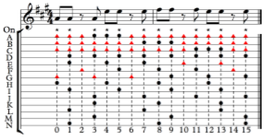
Other recent work by Brian
Published
  Christensen, B. C., Bemman, B., Knoche, H. and Gade, R. (2019). Pass or Fail? Prediction of Students’ Exam Outcomes from Self-reported Measures and Study Activities. Interaction Design and Architecture(s) Journal, 39:44-60.
  Christensen, B. C., Bemman, B., Knoche, H. and Gade, R. (2018). Identifying Students Struggling in Courses by Analyzing Exam Grades, Self-reported Measures and Study Activities. In: 3rd International Conference on Smart Learning Ecosystems and Regional Development (SLERD 2018). Springer. pp. 167-176.
In review
  Johansen, J. J., Jensen, L. G., and Bemman, B. (2019). Evaluating interactions with a cognitively biased robot in a creative collaborative task. Submitted to ArtsIT 2019.
In preparation
  Bemman, B. and Christensen, J. Inner metric analysis as a measure of rhythmic syncopation. In preparation.
Other topics
  Machine classification of music audio for guided imagery in music interventions
    Med6 Project on audio feature extraction for classification of music in Guided Imagery and Music (GIM)
      Christoffer Cæsar Fælled, Konrad Matynia, Marlene Geer Lomborg, Morten Læburgh Larsen

Slide 13
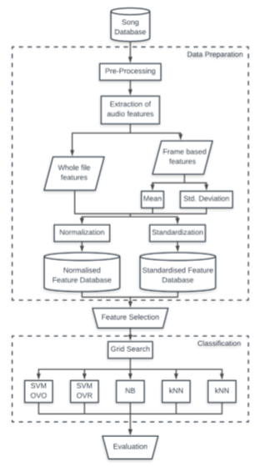
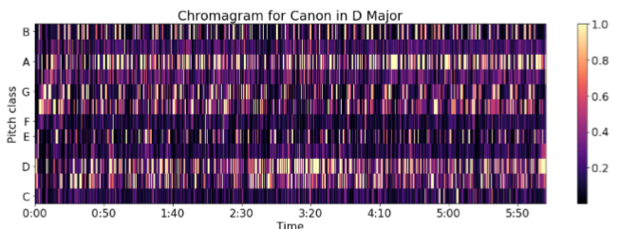
Other recent work by Brian
Published
  Christensen, B. C., Bemman, B., Knoche, H. and Gade, R. (2019). Pass or Fail? Prediction of Students’ Exam Outcomes from Self-reported Measures and Study Activities. Interaction Design and Architecture(s) Journal, 39:44-60.
  Christensen, B. C., Bemman, B., Knoche, H. and Gade, R. (2018). Identifying Students Struggling in Courses by Analyzing Exam Grades, Self-reported Measures and Study Activities. In: 3rd International Conference on Smart Learning Ecosystems and Regional Development (SLERD 2018). Springer. pp. 167-176.
In review
  Johansen, J. J., Jensen, L. G., and Bemman, B. (2019). Evaluating interactions with a cognitively biased robot in a creative collaborative task. Submitted to ArtsIT 2019.
In preparation
  Bemman, B. and Christensen, J. Inner metric analysis as a measure of rhythmic syncopation. In preparation.
Other topics
  Machine classification of music audio for guided imagery in music interventions
    Med6 Project on audio feature extraction for classification of music in Guided Imagery and Music (GIM)
      Christoffer Cæsar Fælled, Konrad Matynia, Marlene Geer Lomborg, Morten Læburgh Larsen

Slide 14
Other recent work by Viktor
Rehm, M., Christensen, B. C., Nielsen, T. B., Rolfsen, R. A., Schmuck, V. (2018). Movement Patterns in Educational Games: Comparing A-Priori and Post-Hoc Analyses. In: O. Mealha et al. (eds.) Citizen, Territory and Technologies: Smart Learning Contexts and Practices. Smart Innovation, Systems and Technologies, 80 DOI 10.1007/978-3-319-61322-2_19.
Ilyas, C. M. A., Schmuck, V., Haque, M. A., Nasrollahi, K., Rehm, M., & Moeslund, T. B. (2019). Teaching Pepper Robot to Recognize Emotions of Traumatic Brain Injured Patients Using Deep Neural Networks. I 28th IEEE International Conference on Robot and Human Interactive Communication (ROMAN) The 28th IEEE International Conference on Robot and Human Interactive Communication.

Slide 15

("BC" comic strip, Mason and Mick Mastroianni, 8 Feb 2008)
https://www.creators.com/read/bc/02/08/48164

Slide 16

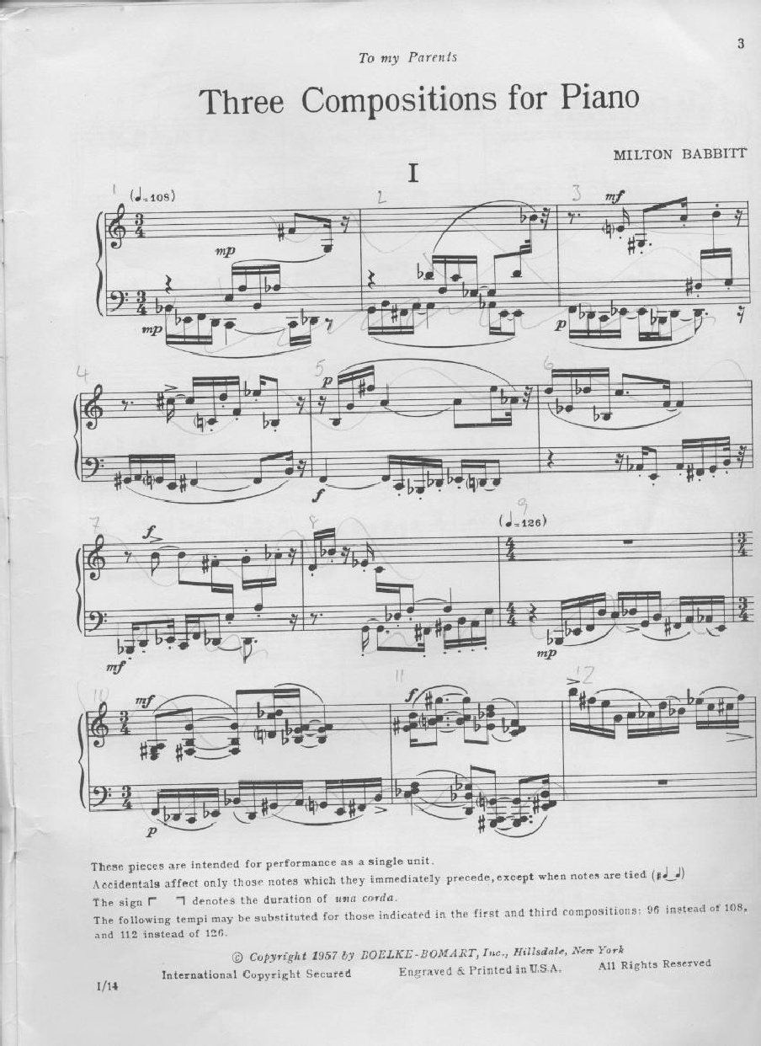
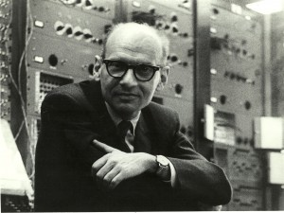
Computational modelling of Milton Babbitt’s compositional processes
Three Compositions for Piano (1947)
Milton Babbitt (1916-2011)
  American composer, music theorist and mathematician
  wrote many articles on 12-tone music theory
  most of his later works based on the all-partition array and the principle of “maximal diversity”
    exhaustively exploring various parameter spaces without favouring any particular elements
Sheer Pluck (Composition for Guitar) (1984)
By Source (WP:NFCC#4), Fair use,
https://en.wikipedia.org/w/index.php?curid=46987269

Slide 17
All-partition array
Array of pitch classes containing k lynes (k=4, 6 or 12)
  A lyne is a structural voice, distinguished from the other lynes by dynamics or register
Satisfies many tough constraints such as
  using all forms of a row exactly once
  using all partitions of 12 with k or fewer summands
    e.g., 58 different partitions when 6 lynes
  pairs of adjacent lynes contain rows arranged into hexachordally combinatorial pairs
  ...
Only a handful of all-partition arrays have ever been discovered

Slide 18
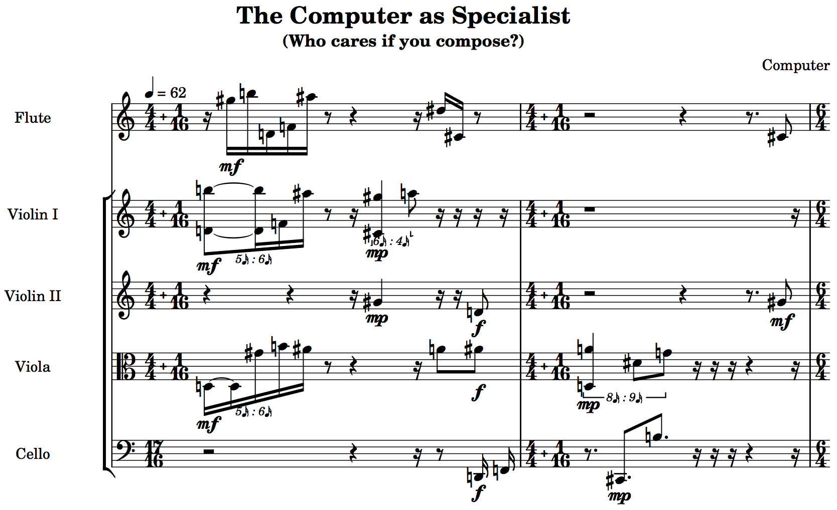

Generating novel works in the style of Babbitt
Automatically generated completely new piece based on the new 4-part array
  pitches, voicing, onsets, duration, metre and dynamics all generated automatically using discovered formalizations of the methods that Babbitt used
Bemman, B. and Meredith, D. (2018). Generating new musical works in the style of Milton Babbitt. Computer Music Journal, 42(1). pp. 60-79.
Bemman, B. and Meredith, D. (2018). Predicting Babbitt's orderings of time-point classes from array aggregate partitions in None but the Lonely Flute and Around the Horn. Journal of Mathematics and Music, 12(1):1-19.

Slide 19
Backtracking search heuristics for solving the all-partition array problem
Problem of discovering an all-partition array given a matrix of pitch classes
Cast as a special case of the set-cover problem
Solved for a 4-lyne array using a constraint programming approach
  First time a novel partitioning has been found automatically
Subsequently solved for a 6-lyne array using a backtracking algorithm starting at both the beginning and the end of the matrix, guided by heuristics based on the number of compositions for each given partition
First time a solution to this problem has been found entirely by computer
Tanaka, T., Bemman, B.M. and Meredith, D. (2016). Constraint programming approach to the problem of generating Milton Babbitt's all-partition arrays. In Rueher, M. (ed.) Principles and Practice of Constraint Programming: 22nd International Conference, CP 2016, Toulouse, France, September 5-9, 2016 Proceedings, Lecture Notes in Computer Science, Vol. 9892, pp. 802-810. Springer, Cham, Switzerland.
  Bemman, B. and Meredith, D. (2016). Generating Milton Babbitt's all-partition arrays. Journal of New Music Research, 45(2). pp. 184-204.
  Bemman, B. and Meredith, D. (2019). Backtracking search heuristics for solving the all-partition array problem. 20th International Society for Music Information Retrieval Conference (ISMIR 2019), Delft, The Netherlands, 4-8 November 2019.

Slide 20
Compression-based, geometric pattern discovery in music

Slide 21
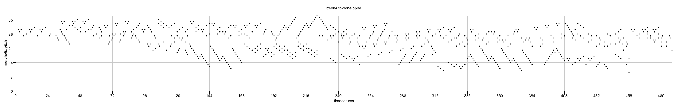
Music analysis and point-set compression
Input point set
J. S. Bach, Fugue in C minor, BWV 847
COSIATEC
SIATECCompress
Forth’s algorithm

Slide 22
Maximal translatable patterns (MTPs)

Slide 23
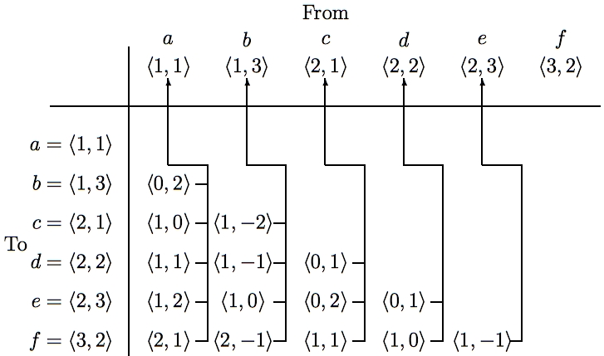
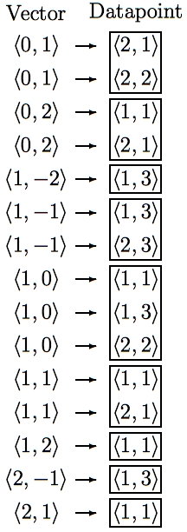
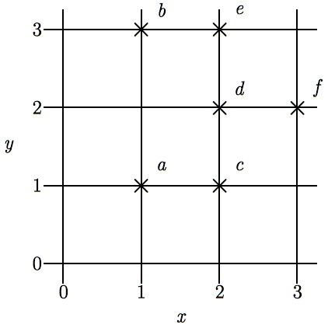
SIA
Discovering all maximal translatable patterns (MTPs)
Pattern is translatable by vector v in dataset if it can be translated by v to give another pattern in the dataset
MTP for a vector v contains all points mapped by v onto other points in the dataset
O(kn² log n) time, O(kn²) space
O(kn²) time if use direct address table to store vectors
Notes:
The first algorithm I’m going to describe is the SIA algorithm which takes as input a multidimensional point set and discovers, for every vector, the points in this point set that are mapped onto other points in the point set by that vector.
For convenience, I’ll call the complete set of points being analyzed the DATASET and any subset of the dataset a PATTERN.
I say that a pattern is TRANSLATABLE by a particular vector within a dataset if it can be translated by that vector to give another pattern in the dataset. For example, the pattern {a,d} here is translatable within this dataset by the vector <1,0>.
And the pattern that contains ALL the points that are mapped onto other points in the dataset by a particular vector is the MAXIMAL TRANSLATABLE PATTERN for that vector. So the maximal translatable pattern or MTP in this dataset for the vector <1,0> is the pattern {a,b,d} and the MTP for the vector <1,1> in this dataset is {a,c}.
So SIA discovers all the non-empty maximal translatable patterns in a dataset.
It does this by first sorting the points in the dataset into lexicographical order and then computing the vector from each point to every other point in the dataset that is lexicographically greater. These vectors are stored in a table like this one here which we call a VECTOR TABLE. And each vector is stored with a pointer that points back to the origin point for which it was computed, as indicated by these arrows here.
The vectors in this table are then sorted into lexicographical order to give a list like the one here on the right and the MTP for each vector can be found directly by reading off the points attached to the adjacent occurrences of that vector in this list.
The most expensive step is sorting the vectors which can be done in O(kn^2 log n) time. However, by storing the origin points in a hash table and hashing the vectors to get the slot indices, this time complexity can be reduced to O(kn^2).
And also, obviously, the space used is O(kn^2)

Slide 24
Translational equivalence classes (TECs)

Slide 25
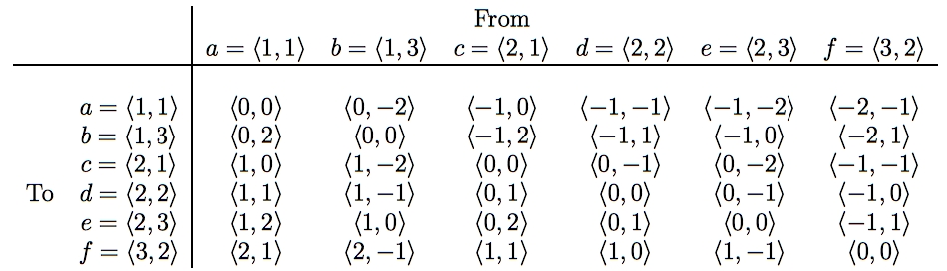
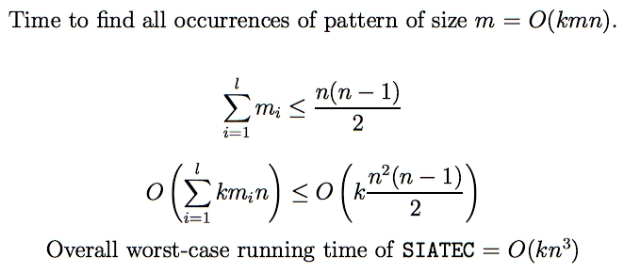
SIATEC
Discovering all occurrences of all MTPs
Translational Equivalence Class (TEC) is set of all translationally invariant occurrences of a pattern
Notes:
SIA only finds one occurrence of each MTP and one vector by which that MTP is translatable within the dataset.
SIATEC, on the other hand, finds all the MTPs using a slightly modified version of SIA and then finds all the vectors by which each MTP is translatable within the dataset.
In other words, it finds all the non-empty MTPs and then all the patterns within the dataset that are translationally equivalent to each MTP.
In SIA, we only needed to compute the vector from each point to every lexicographically greater point because the MTP for a particular vector -v is the same as the pattern that you get by translating the MTP for v by v itself.
However, in this simple implementation of SIATEC, we can find all the occurrences more efficiently by computing all the interpoint vectors and storing them in a table like this one here.
If the points in the dataset are sorted into lexicographical order first, then the vectors in this table increase lexicographically as you descend a column and go from right to left along a row.
Each column contains all the vectors by which the point at the top of the column is translatable within the dataset.
Therefore the set of vectors by which a given pattern in the dataset is translatable is equal to the intersection of the columns headed by the points in that pattern. For example, the pattern {a,c} is translatable within this dataset by the intersection of the columns for which a and c are the original points.
By exploiting the orderedness of this table, we can find all the occurrences of a k-dimensional pattern of size m in a dataset of size n in a worst case running time of O(kmn).
Now, all the MTPs in a dataset can be found by reading through the list of sorted vectors generated by SIA so we know that sum of the cardinalities of the MTPs is less than or equal to n(n-1)/2.
Therefore the worst case time complexity of this implementation of SIATEC is [as shown] which implies that it is O(kn^3).
And, obviously, it uses O(kn^2) space.

Slide 26
Compression with TECs

Slide 27
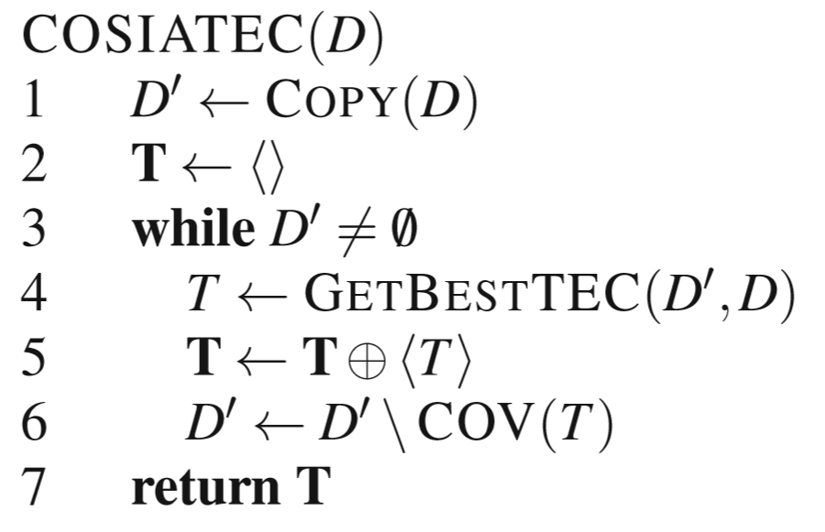
COSIATEC
Compression and covering with MTP TECs
Start
Dataset
SIATEC
Computes a set of TECs that collectively cover the input dataset
The dataset is exclusively and exhaustively partitioned into TEC covered sets
Typically gives better compression than the other strategies tried
List of <Pattern, Translator_set> pairs
Add best TEC, <P,V> to encoding
Remove points covered by <P,V> from dataset
Is dataset empty?
No
Yes
Output encoding
Notes:
We can use SIATEC together with the heuristics I’ve just described to construct a simple compression algorithm which I call COSIATEC. COSIATEC works like this.
First we use SIATEC to generate a list of <Pattern, Translator_set> pairs in which each pattern is an MTP and each translator set contains all the non-zero vectors by which the pattern is translatable within the dataset. This generally gives a more efficient representation of the set of points covered by the occurrences of a pattern.
Then we can use the heuristics I’ve just described - compression ratio, coverage and compactness - to choose the “best” pattern P and this pattern is printed out together with its translator set.
Then all the points covered by P and its occurrences are removed from the dataset.
Then if the dataset is empty, we end; otherwise, we again run SIATEC on the remaining points in the dataset.
The result is a print out of the “best” pattern and its translators for each iteration of the cycle and this printout is usually a compressed representation of the input dataset.
Obviously, the degree of compression achieved depends on the amount of repetition in the dataset.

Slide 28
SIATECCompress
Compression and covering with MTP TECs
Sorts TECs into decreasing order by "quality"
  Quality is a function of compression factor, compactness and coverage
Scans list, adding TECs to output encoding if they increase encoding length by less than the number of extra points that they cover
TEC covered sets in generated cover may intersect
Typically lower compression factor than COSIATEC
Adds a TEC to encoding if its <P,Θ> representation is shorter than the set of new points covered

Slide 29
Forth’s algorithm
(Forth 2012, Forth and Wiggins 2009)

Slide 30
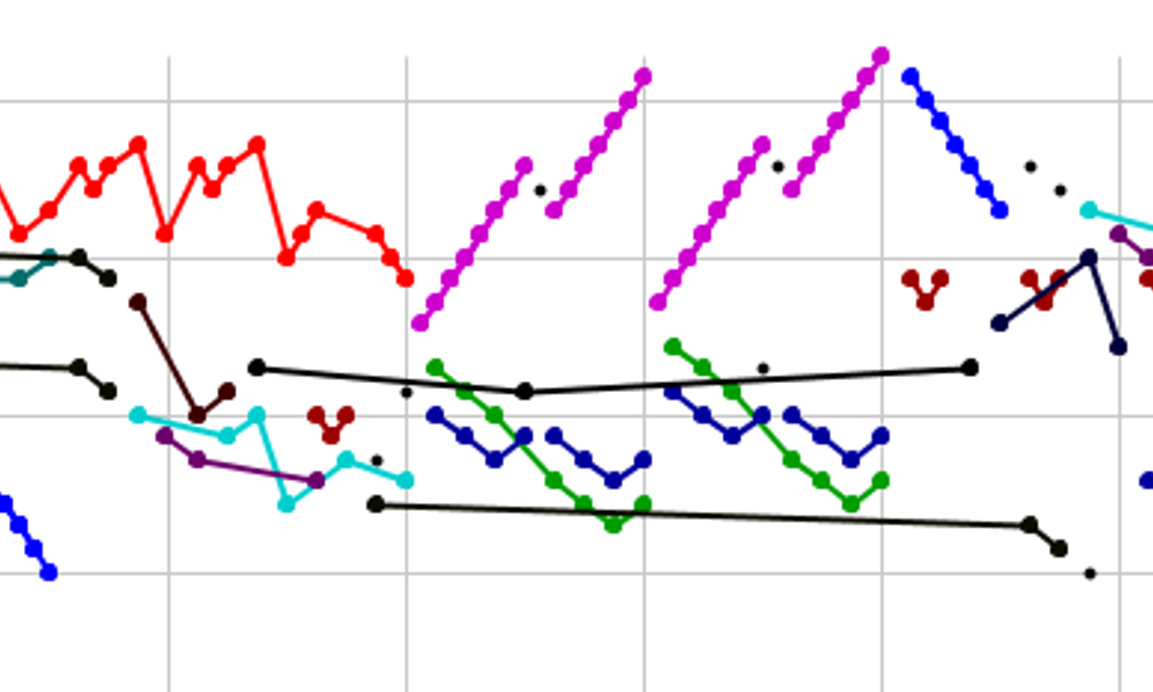
SIACT and SIAR
(Collins et al. 2010, Collins 2011)
r=2

Slide 31
Recursive translatable pattern discovery:
RecurSIA

Slide 32
Removing redundant translators:
RRT

Slide 33
Putting it all together:
OMNISIA

Slide 34
Finding optimal OMNISIA parameter values:
OPTISIA

Slide 35
Papers accepted or published since April 2018
Modelling Milton Babbitt's compositional process
Convolutional methods for music analysis
Modelling musical memory and attention
Deep learning methods for collision avoidance in mobile robots
Compression-based, geometric pattern discovery in music
April 2018
  Bemman, B. and Meredith, D. (2018). Generating new musical works in the style of Milton Babbitt. Computer Music Journal, 42(1). pp. 60-79.
May 2018
  Velarde, G., Cancino Chacon, C., Meredith, D., Weyde, T. and Grachten, M. (2018). Convolution-based classification of audio and symbolic representations of music. Journal of New Music Research, 47(3). pp 191-205.
  Bemman, B. and Meredith, D. (2018). Predicting Babbitt's orderings of time-point classes from array aggregate partitions in None but the Lonely Flute and Around the Horn. Journal of Mathematics and Music, 12(1):1-19.
July 2018
  Agres, K. R. and Meredith, D. (2018). Modelling novice and expert listeners' ability to detect changes in short melodies. 15th International Conference on Music Perception and Cognition/10th Triennial Conference of the European Society for the Cognitive Sciences of Music (ICMPC15/ESCOM10), Graz, Austria, 23-28 July 2018.
April 2019
  Schmuck, V. and Meredith, D. (2019). Training networks separately on static and dynamic obstacles improves collision avoidance during indoor robot navigation. 27th European Symposium on Artificial Neural Networks, Computational Intelligence and Machine Learning (ESANN 2019), Bruges, Belgium, 24-26 April, 2019.
August 2019
  Meredith, D. (2019). Music analysis and data compression. In: Grimshaw-Aagaard, M., Walther-Hansen, M. & Knakkergaard, M. (eds.), The Oxford Handbook of Sound and Imagination, Vol. 2.
September 2019
  Meredith, D. (2019). RECURSIA-RRT: Recursive translatable point-set pattern discovery with removal of redundant translators. 12th International Workshop on Machine Learning and Music (MML 2019), Würzburg, Germany, 16 September 2019.
  Schmuck, V. and Meredith, D. (2019). OPTISIA: An evolutionary approach to parameter optimisation in a family of point-set pattern-discovery algorithms. 12th International Workshop on Machine Learning and Music (MML 2019), Würzburg, Germany, 16 September 2019.
November 2019
  Bemman, B. and Meredith, D. (2019). Backtracking search heuristics for solving the all-partition array problem. 20th International Society for Music Information Retrieval Conference (ISMIR 2019), Delft, The Netherlands, 4-8 November 2019.

